Slide 1
Multi Scale Thermal Problem BTP-1
Akella Kalyan Lakshmi Sriniwasa
21ME10010

Slide 2
INTRODUCTION
Computational Fluid Dynamics (CFD) is essential for simulating complex fluid flows, but these simulations are often resource-intensive and slow, limiting their practical use in real-time or large-scale applications.
The demand for faster and more efficient simulations is growing in all fields, making it crucial to develop methods that can reduce simulation time without compromising accuracy.
Parallelization distributes tasks across multiple processors, significantly reducing computation time. Directive-based frameworks like OpenACC enable parallel processing on GPUs, making them highly effective for speeding up CFD models.
This project aims to evaluate OpenACC’s potential to enhance CFD simulations by applying it to a simple 2D heat equation model and then utilize it to speed up a CFD solver, ArtraCFD. In this phase, only the profiling of the solver has been done, and the speeding up will be done in the next phase.

Slide 3
THEORY
Parallelization distributes computational tasks across processors, significantly speeding up time-intensive simulations, making it essential for handling complex CFD problems efficiently.
OpenACC, a directive-based framework, simplifies parallelization by allowing developers to offload code sections to GPUs with minimal changes, accelerating CFD models with less programming overhead.
The Immersed Boundary Method (IBM), allows for simulation around complex and moving boundaries by embedding boundary conditions into the fluid grid, eliminating the need for body-conforming grids and simplifying complex geometries.
IBM assigns flow properties to boundary points using weighted averages from nearby fluid points, enabling accurate boundary condition enforcement for irregular or moving geometries, such as solid-fluid interactions.
IBM’s structure makes it well-suited for parallelization, as its non-conforming grid allows fluid and boundary updates to be handled independently, maximizing efficiency in high-resolution and dynamic simulations.

Slide 4
METHODOLOGY
1. 2D Heat Equation Simulation
A 2-dimensional, steady state heat diffusion equation was simulated on a square plate of size 2, which was had smaller grids of size 0.01*0.01. The boundary conditions were T(x,y)=0 if x=0 or y=0 and T(x,y)=1 if x=2 or y=2. The experiment aimed to observe the runtime reduction by comparing CPU-only code to an OpenACC-parallelized version.
Fixing the plate size at 2, tests varied from 100,000 to 1,000,000 steps. Subsequently, the grid size was varied from 0.2 to 2, while keeping the number of time steps fixed at 100000. The results obtained in both experiments were plotted, and the runtimes were recorded.
2. Flow Simulation Around a Cylinder with ArtraCFD
ArtraCFD was used to simulate inviscid fluid flow around a stationary cylinder, with an initial flow velocity of 2.42 m/s and specified density ,temperature and pressure parameters. The primary focus was profiling to identify high-computation sections for optimization. These sections would be parallelized in the next phase(BTP 2).

Slide 5
BRIEF EXPLANATION OF COMPUTATIONAL TOOLS
OpenACC: OpenACC is a high-level parallel programming model that uses compiler directives to offload tasks from the CPU to the GPU, enhancing performance with minimal code restructuring. Designed for C/C++ and Fortran, it allows existing programs to run on GPUs with ease, supporting scalable computations in scientific applications through simple annotations.
ArtraCFD: ArtraCFD is an advanced CFD solver that employs temporal (RK2 and RK3) and spatial (WENO3, WENO5) discretization techniques for accurate fluid dynamics simulations. It integrates the Immersed Boundary Method to handle complex geometries and solid-fluid interactions efficiently, making it highly adaptable for varied and intensive CFD simulations.

Slide 6
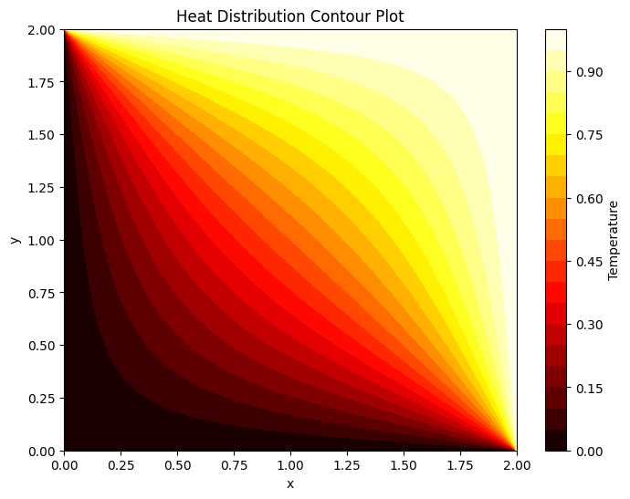
RESULTS: HEAT EQUATION
The plot on the left was obtained through CPU code and that on the right through OpenACC parallelized code

Slide 7
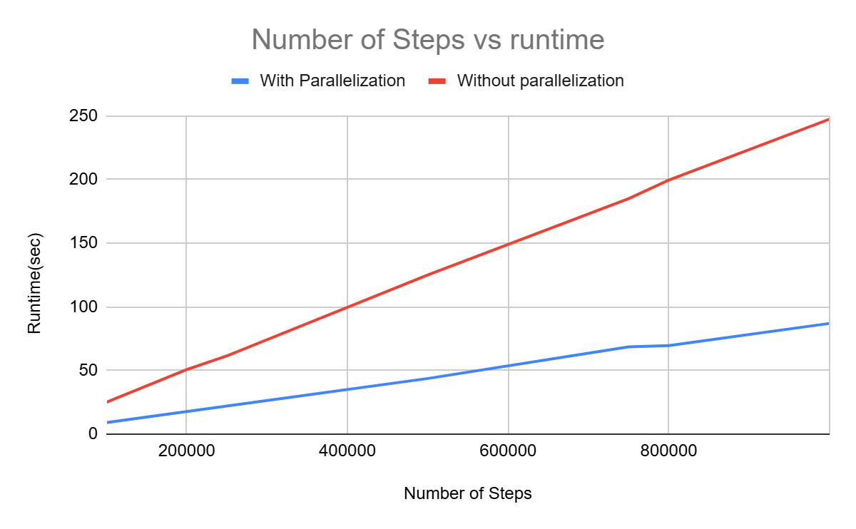
RESULTS: HEAT EQUATION
The graph below is a graph showing the number of steps vs runtime for both CPU and GPU codes.

Slide 8
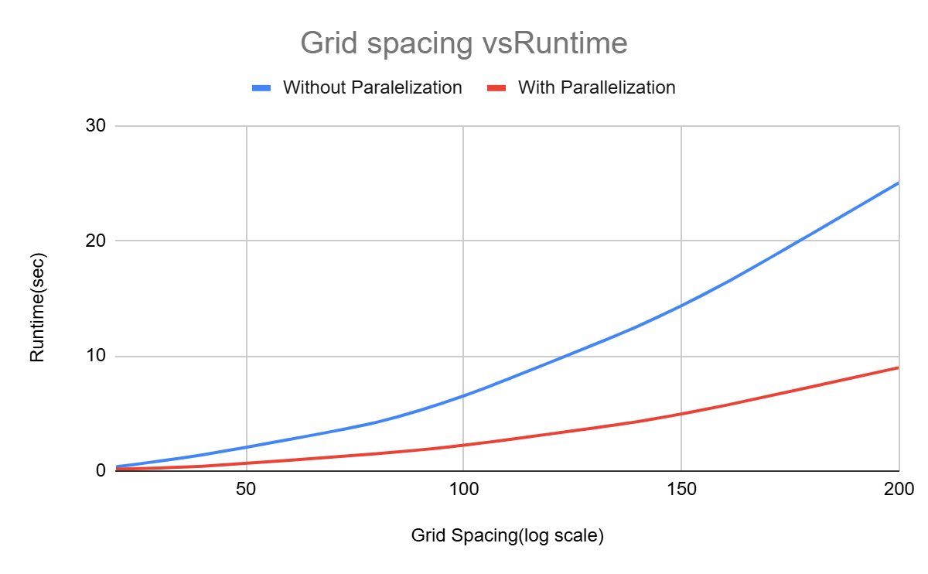
RESULTS: HEAT EQUATION
The graph below is a graph showing the number of grids per unit length vs runtime for both CPU and GPU codes.

Slide 9
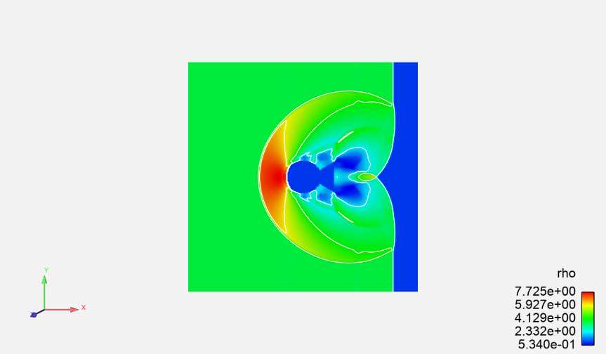
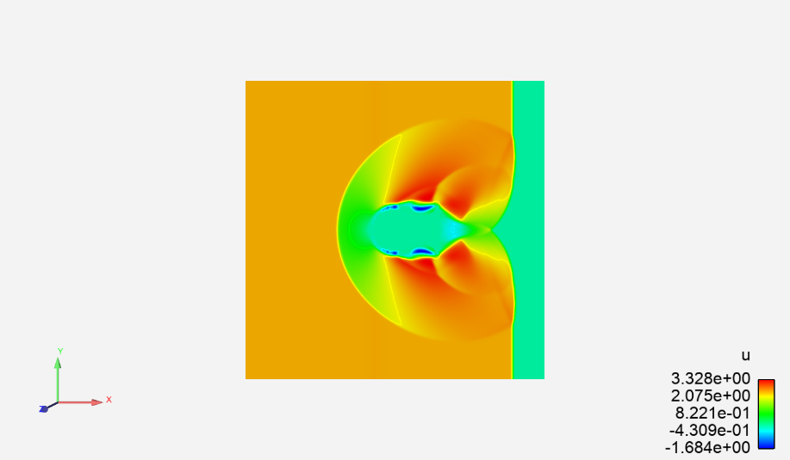
RESULTS: ArtraCFD
The graphs in the following slides show the profiles of density and velocity respectively as contour plots.

Slide 10
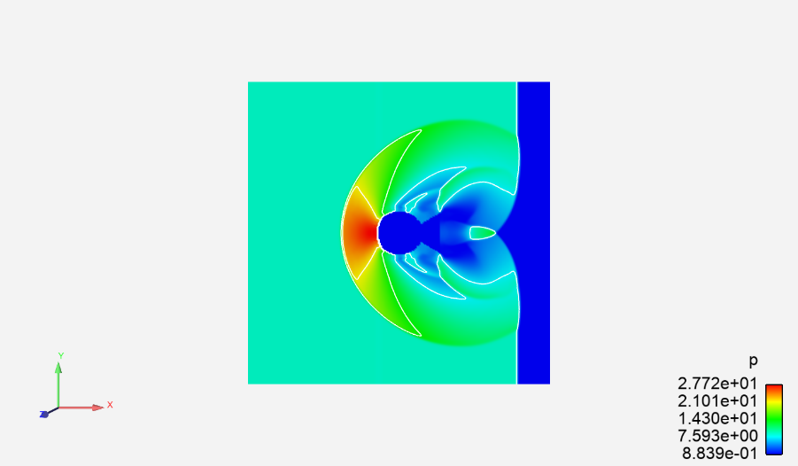
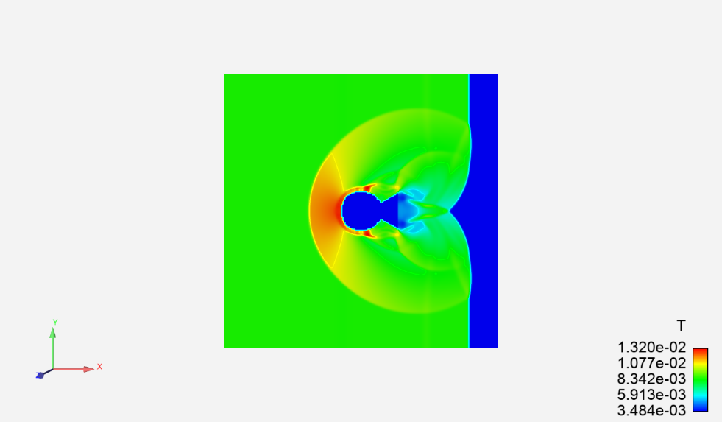
RESULTS: ArtraCFD
The graphs in the following slides show the profiles of pressure and temperature as contour plots.

Slide 11
RESULTS: ArtraCFD PROFILING
Profiling Results: The main function's most time-consuming operation was the Solve function, taking 77.338 seconds. Within the Solve function, the EvolveSolution function was the bottleneck, accounting for 76.527 seconds. Delving deeper into EvolveSolution, the EvolveFluidDynamics function was identified as the next performance hotspot, consuming 0.423 seconds. Within EvolveFluidDynamics, the DiscretizeTime function ran multiple times, with four instances in the sample test case, each averaging 0.96 seconds.
DiscretizeTime calls the IntegrateTime function, which in turn invokes RungeKutta3. While IntegrateTime and RungeKutta3 ran for approximately 0.96 and 0.086 seconds, respectively, the longest runtime within RungeKutta3 was taken by the LLLU function, consuming 0.034 seconds. Importantly, LLLU did not invoke additional functions, leading to the conclusion that profiling could go no further.

Slide 12
CONCLUSIONS
The initial 2D heat equation experiment achieved a 65% runtime reduction using OpenACC, validating the effectiveness of directive-based parallelization for accelerating simpler CFD models.
Profiling of ArtraCFD pinpointed key functions, especially EvolveSolution and EvolveFluidDynamics, as primary areas for optimization, which will be the focus for further parallelization efforts.
This phase provided valuable insights into OpenACC's capabilities, laying the groundwork for deeper optimization in ArtraCFD, particularly targeting high-computation functions to enhance simulation speed.
The next project phase (BTP 2) will focus on fully integrating OpenACC into ArtraCFD, aiming for greater speedup and efficiency in handling complex CFD applications, thereby expanding the solver’s utility for high-performance simulations.

Slide 13
Q&A

